Slide 1

Economy: 6 pillars + theory + current + BES17 (Budget & Eco. Survey 2017)
1) Banking 2) Finance 3) Insurance, 4) Financial Inclusion
1.Banking, Fin, Insur.
6.HRD
2.Budget
3.BoP
4.Sectors
5.Infra
V1:c3,4
V1:c2,3, 6,9,11(GST),13
V1c:5
V1c:7(Textile),11(trade)
V1c:10
v1c:12, 14; Budget^Rail

Slide 2

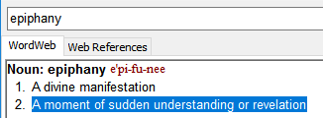
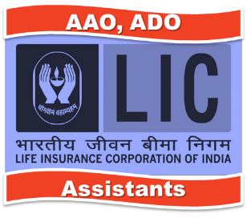
Insurance
This icon means the given slide is more imp for insurance jobs than for UPSC IAS/IPS. But doesn’t mean completely ignore, since ‘horizontal’ awareness necessary.
BEFORE "L2" Series
155
After "BES171"
~50 [theory + contemporary]
Govt schemes- separately under the Fin.inclusion

Slide 3
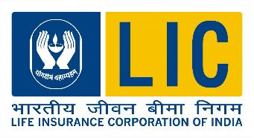

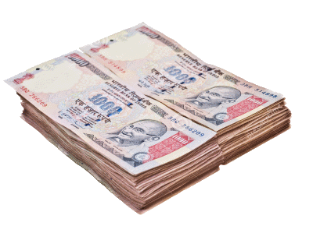

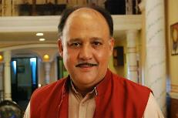
Debt instrument.
Social device / legal contract
Against eventualities of death / damage
Life
Non-Life (General)
Premium
Insurer
Assurer
Underwriter
Insured
Assured
Client
Notes:
What is insurance?

Slide 4
Why is insurance important for economy?
Insurance
Household: Stability in household against death / disability /damage– else child labour & prostitution
“state”: ▼ burden on Government to run social security schemes: ▼ fiscal deficit
Entrepreneur: fire, theft= can’t take bold decisions without insurance of property, transport etc.
Economy: Insurance as an “FI”: turns savings into investment – circular flow of money. Has to invest part of premium in social / economy infrastructure (PSL).

Slide 5
What’re the principals of insurance? [Ethics]
Already HIV/cancer and buying health insurance with fake medical Certi.
Indemnity
Only to extend of “REAL” loss, not imaginary
Subrogation
Insurer can Recover from negligent 3rd party
Causa proxima
Direct loss link (explosion w/o fire= no $$)
Uberrima fides
Good faith, hide nothing
Insurable interest
If “x” not happen, client remains in same position, “x” happens client in bad position
5 lakh rs. House burnt, couldn’t give CAT exam= give rs.50 cr rupees
faulty boiler caused explosion?
Fan buying accident insurance for Tiger Shroff

Slide 6
Insurance: History & mathematical Models
4500 BC
1347
1688
Babylonia Caravans
European Maritime Insurance
Llyod’s Coffee House, UK as meeting place of insurance agents
1967
Dr. Nicolas Barbon
1st Fire insurance
1756
1st life insurance co. “Old Equitable”, UK
Jakob Bernoulls (1700)
Laws of Large numbers
Edmund Haley (1693)
Mortality table
Premium vs. lifespan
To predict average total loss /liability of company
Joseph Dodson updated

Slide 7

In India
Insurance History
1000 BC: Aryans practiced “community insurance”, Joint family system itself insurance
Rigveda: “Yogakshema” (well being) – name of LIC HQ, Mumbai & corporate magazine
Gita: “योगक्षेमं वहाम्यहम्” (Yogakshemam Vahamyaham)- I ensure safety and well being (of my devotees) – LIC motto

Slide 8
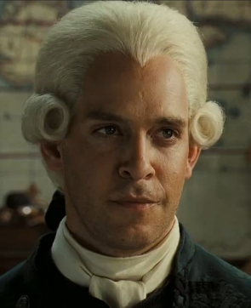
Insurance companies in British India
1850:
1907:
1919:
1st General insurance: Trinton, Calcutta
Indian mercantile insurance ltd. Bombay
New India Assurance- 1st fully Indian owned (general)
1870:
Bombay Mutual life assurance company- first INDIAN company.
1818:
1st Life insurance co. in India: Oriental Life insurance.

Slide 9
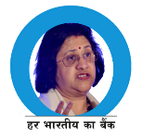
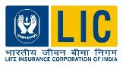
Both started by foreigners
Presidency Banks
1806-45->1921->55
Target
Merchants, foreigners
Swadeshi
Allahabad (?, 1865), PNB (1894)
Insurance
1818: Oriental life (1st)
Targets
foreign widows, Indians charged extra premium “more likely to die”
Swadeshi
1870: Bombay Mutual life assurance. [no extra premium]

Slide 10
Both faced problems in aftermath of Great depression
1912:
1938:
Life insurance companies act
Insurance Act
RBI Act
1934
1949
Banking regulation Act
1913
Companies Act
Aftermath of great depression and collapse of companies

Slide 11
both had to be Nationalized due to scams, fin-exclusion
1948
RBI nationalized
1955
Imperial Bank->SBI
Private Banks
1969 (14 banks)
1980 (6 banks)
1956 (Corporation)
LIC Act took over ~245 desi, foreign, provident society & insurance co.
1972 (Corporation)
GIC & its four subsidiaries took over ~107 GI

Slide 12
1972: General insurance Nationalization Act
Government
GIC
Natl.insurance
New India assurance
United India
Oriental
Holding
Owner
Subsidiary Companies
2002: Govt takes direct control
Allowed to issue more shares, provided Government shareholding alteast 51%
5th Agri. insurance Company ltd. (2002)
Notes:
Commerce Ministry has “National Export insurance Account” (NEIA, in 2006) for projects where ECGC can’t accept clients due to business reasons.

Slide 13
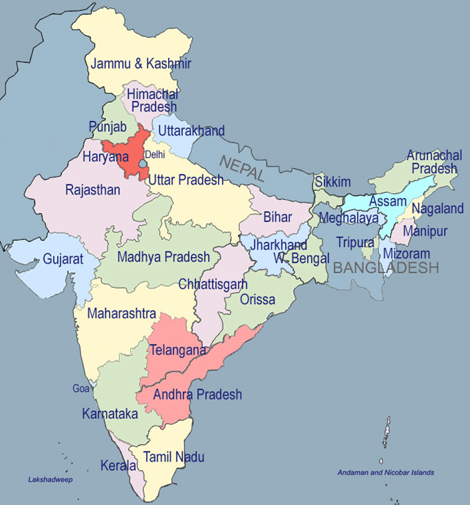
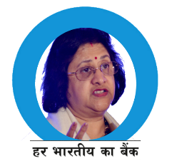
PNB: 1894
Punjab-Sind (’08)
SBPatiyala (‚17)
OBC (‘43)
SB Bik&Jai (40s-63)
DESHI BANK?
Distribution of Banking Industry
Near Ports, Trading Centres
BMB ‘13
UCO-United Commercial ‘43
United Bank of India ’50
Bandhan Microfin’14
Bank of India (‘06)
Central Bank of India (‘11)
Union Bank (‘19)
RBI (’34-35)
Bank of Maharashtra (‘35)
Dena Bank (‘38)
IDFC NBFC’14
Corporation (06)
Canara Bank (’10)
SBMysore(13)
Syndicate bank (‘28)
Vijaya (‘31)
Andhra bank: 1923; ’41 SBHyd
TN: Indian Bank (‘23); Indian Overseas bank(‘37)
SBTravenkore’45
Notes:
*in principle approval

Slide 14


General insurance companies
In the presidency cities, from North to South
Oriental insurance
1947 – Govt. owned company, HQ Delhi
56: under LIC , 73: under GIC, 2003: independent
Insured Reliance-Jamnagar
Power, steel, chemical plants
National insurance
1906, HQ: Kolkata, During Swadeshi Movement era
Strong presence in North & Eastern region
New India Assurance
1919, Mumbai, Sir Dorabji Tata
1st Fully Indian owned. Now 100% Govt.owned
Major player overseas market
Satellite insurance (INSAT 2E)
United India 1938, HQ: Chennai
2nd Largest General insurance Co. (2013)
Insured ONGC’s offshore assets (2015, May); Tirupati, Airport-Hyderabad, Mumbai

Slide 15

Types of insurance?
Life (~80%)
Non-Life / General insurance
Re-insurance

Slide 16


Life insurance types
Type
Endowment
@Maturity
@Death
Yes
Yes
ULIP
Yes
Yes
Whole Life
No
Yes
Term
No
Yes
Low premium, Short term
Life Ensured for 1 year @2 lakh
Rs. 330 per year. No moneyback if you don’t die.
Premium $$ invested in a fund
Return =~ Fund’s Performance
Debt | balanced |equity fund
Lost shine after Sub-prime crisis

Slide 17
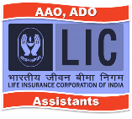
What are the challenges to life insurance biz.?
ULIPs lost shine after subprime crisis hurt Indian share market
Inflation – negative REAL interest
Consumers Shifting from insurance to “pension” for better returns while being “ALIVE”
Cost of ops. High, need more working capital : hence FDI 49% permitted.
Agents focus on “selling” from tax-benefit / “rate of return”, rather than generating awareness abt need for insurance
=> other pension / investment products with better returns & tax benefits
=> rural penetration low, because they’re not income tax payers, & see +ve real return in gold
Reforms taken in insurance amendment: Life insurance policy can be used as collateral for loan- unless insurance company disagrees. Will help the farmers / families to borrow

Slide 18
General Insurance, Major Types
Fire
Motor (largest biz)
Health insurance
Cashless/ reimbursement
Houses, industrial assets
Marine
Cargo, vessel
Rural
Crops, livestock
Accident cum Death
3rd party: insures party other than owner – Compulsory under law
Comprehensive: both owner & others

Slide 19

What are the challenges to general insurance biz.?
Motor vehicle
Fear of discovery of ‘value’
IT raids & ransom demands
Only 3rd party because compulsory.
Not doing “comprehensive”
MSME industries: transit / operation
“Value” for money , tailormade products….x
Adverse selection
Risky persons buying- e.g. high BP, Obese, diabetic person
Moral hazard
Insured vehicle- careless to lock it
House fire / theft

Slide 20
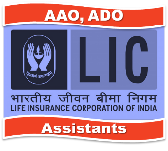
What are the challenges to health insurance?
Insurance: Highly regulated, but Healthcare: highly unregulated.
Supply demand mismatch: between (doctors-hospitals) vs. patients
standardized treatment costs difficult to ascertain, unlike car damage.
Delays in claim settlement: less repeat customers
Third party administrators (link client, hospital) - their substandard service
Higher premium for elderly

Slide 21

What are the Business Risks in insurance industry?
Portfolio
If too much focus on health but then SARS / Ebola?
Non-life: heath, motor, marine product
Market
Financial market ups and downs, but Clients want optimal return
Marketing
Changing demography and alt. distribution channels
Operational
Database hacking, Poaching of staff / agents
death, disease, disasters ▲

Slide 22

What’re common challenges to life & general insurance?
Capital intensive industry: high commission, marketing, training, salary-database, solvency margin…hence FDI necessary (49% permitted)
Private players not generating enough profits.
Bleeding in commission rates and marketing
Insurance is ‘sold’, but never bought, brokers need more skill, network than banker.
Banking- asset driven industry, while insurance is liability driven industry.
Rural people: either disinterested / un-served despite schemes & IRDA norms.
End result: insurance penetration and density low.

Slide 23
Definitions
total insurance premium/total GDP
Insurance density
Total Premium / Total population
Or Per capita premium
Insurance Penetration
%

Slide 24
Types of insurance?
Life (~80%)
Non-Life / General insurance
Re-insurance

Slide 25
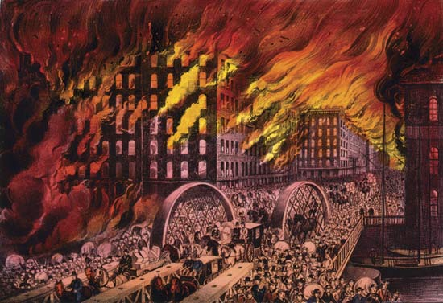
Re-insurance: to stabilize peak profit and peak loss…
Profit
Great Loss
New York fire (1835)
Chicago fire (1871)
London (1966)
If no plane-crash…
If no pandemic
Life Insurance
General Insurance
Re-Insurance
Notes:
Great NewYork fire (1835), Chicago fire (1871), London (1966)
Re-insurance needed to stabilize peak profit and peak loss
“spread out the risk”
Protect against unpredictable events such as airline crash, large scale damages.

Slide 26
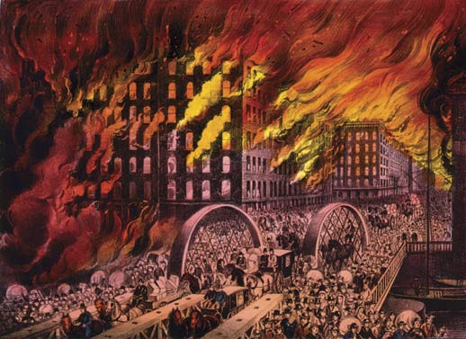

Re-insurance: to stabilize peak profit and peak loss…
1972: General Insurance biz nationalization Act
2002 Amendment
Private General Insurance cos nationalized
Restructured: GIC + 4 subsidiaries
4 subsidiaries transferred directly under Govt. ; GIC “wholly owned Company” of Govt.
2000 Amendment
Gen. Insurance Corporation of India (GIC) to be sold reinsurer
GIC Invests money in G-sec, UTI, securities of private and public cos.
GIC insures Air India, HAL, AAI directly and Manages third party motor pool
2015: Insurance Act Amendment
More than one RE allowed.
2015, Dec: IRDA notification, private players can apply min. 100 cr. Capital.
Notes:
As such LIC capable of sustaining the losses
But IRDA norms Reinsurance mandatory for both life and General
1972: General insurance nationalized
2000: GIC becomes India’s only re-insurer
2002: 4 subsidiaries became directly owned by Government.
GIC insures Air India, HAL, AAI directly and Manages third party motor pool
GIC Invests money in G-sec, UTI, securities of private and public cos.
2015 insurance amendment allowed entry of more.
Under insurance Act, only 1 rE=“GIC”
2015, Dec: IRDA – private players can apply min. 100 cr. Capital.

Slide 27
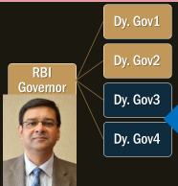

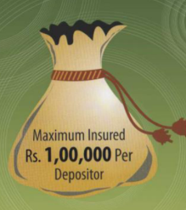
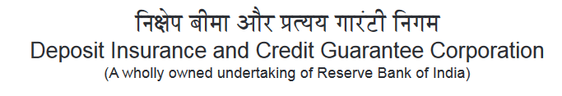
Act 1961: 100% owned by RBI, HQ-Mumbai
One of them is Chairman
Client- all type of deposits
Banks- All types
Premium from their own pocket
Max. 1 lakh insured
If banks is shut down
If bank is merged..not possible
Notes:
Both commercial and cooperative.
Deposit insurance and credit guarantee corporation (DICGC)
100% RBI owned (1978)
1 of the 4 Dy.Director of RBI is chairman of this body
Link More details on function

Slide 28

DICGC: Credit Guarantee? (no longer after 2003)
Banks pay fee ~0.3% of loan
If NPA->money from fund.
Govt to SIDBI
4:1 contribution.
SIDBI + Govt
Dept. of Financial services
National Credit Guarantee Trustee Company (NCGTC)
Skill development loans Stand up India
Credit Guarantee Fund Scheme for Educational Loans (CGSEL)
Credit Guarantee Fund Trust for Micro and Small Enterprises (CGTMSE)- 2000
MUDRA Loans
Commerce Ministry
Export Credit Guarantee Corporation of India fund
ECGC ltd.
Notes:
http://www.livemint.com/Industry/GXIG1Tj6jqyrujFYYzaxaK/Centres-credit-guarantee-scheme-worries-RBI.html

Slide 29
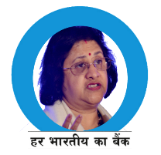

Both had to setup new statutory bodies
Narsimhan I (1991) & II (1998) [RBI Gov]
Malhotra Committee 1993 [IAS, RBI Gov.]
1996: IRDA setup,
RBI already since 1934
DRT->SARFAESI Act 2002
Payment regulation & settlement system act-> PRB (Budget 2017)
1999: Act
2014: ordinance name changed: Insurance regulatory and Development authority of India. (IRDAI)
First and only person to become Gov from RBI Officer cadre.
Notes:
https://www.rbi.org.in/scripts/governors.aspx#narasim

Slide 30
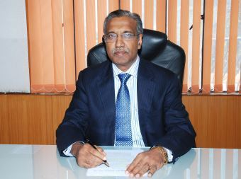
GSM2: Write structure and function of IRDAI
Previously- IAS, IRS used to get IRDA chief position. But..
1977: TS Vijayan: LIC career officer
2006: LIC Chairman
2013: IRDAI chief
Chairman
5 Fulltime
4 Part time
5 yr / 62 age
5 yr / 65 age
TS Vijayan
Total 10, re-appointment yes.

Slide 31

GSM2: Statutory, Regulatory Bodies- IRDAI
RBI gave blanket permission to all NBFCs to run insurance business, But they have to get IRDAI registration.
IRDAI doesn't have 'quota', but gives separate licenses for life and general. Min. capital 100 cr.
Registration, renewal and regulation, Withhold, suspend, cancel registration
Accounting, solvency, audit, commission to agents …Appeal-> SAT
Member of International association of Insurance Supervisors (IAIS), Basel, Switzerland.

Slide 32
Mock Question
Which of the following bodies have HQ in Mumbai?
RBI
SEBI
IRDAI
PFRDA
Answer Choices
Only 1 and 2
Only 1, 2 and 3
Only 1, 2 and 4
All of them
RBI, SEBI: Mumbai
IDRAI: Hyderabad, Telengana
PFRDA: Delhi

Slide 33
Both had interest / tarrif control
Narsimhan I (1991) & II (1998)
Malhotra Committee 1993
Administered interest rate
BPLR
Base Rate
MCLR (2016)
Insurance Act-> “Tariff advisory committee”
Decide the premium, slabs.
2007: GI- De-tarrified, except 3rd party motor.
Premium: statistics, probability theory, demographic trend, return in financial market.
Lending Rates:
Cost of Raw material ($$)+Spread

Slide 34
Both had to dilute Government shareholding
Narsimhan I (1991) & II (1998)
Malhotra Committee 1993
Allow insurance companies to issue new shares [ownership 51%]
Dilute Government shareholding
SBI -> ~60%

Slide 35
How many Public sector Players? players?
Narsimhan I (1991) & II (1998)
Malhotra Committee 1993
PSB: 27-5 associate – 1BMB= 21 left
1 LIC,
5 General [4+1],
1 re-insurer (GIC)

Slide 36
Both had to be allow private players entry
Narsimhan I (1991) & II (1998)
Malhotra Committee 1993
2000: Private cos. Allowed.
Allow Private banks & Foreign Banks
2015- FDI: 49% (earlier 26%)
1993, 2001, 2013
Private Banks FDI: 74%
2016: automatic route

Slide 37
How to setup new entity ? Min. Paid up capital
Bank (on-tap)
Insurance
UsCB: 500 cr. [BASEL-III 9% CRAR]
PB, SFB: 100 cr. [15% CRAR]
Life, health, gen. insurance: 100 cr
Re-insurer: 100 cr. [2015 rule]
Notes:
https://rbi.org.in/scripts/bs_viewcontent.aspx?Id=2900

Slide 38
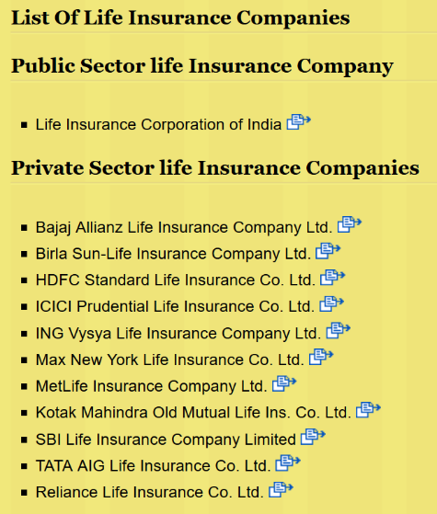
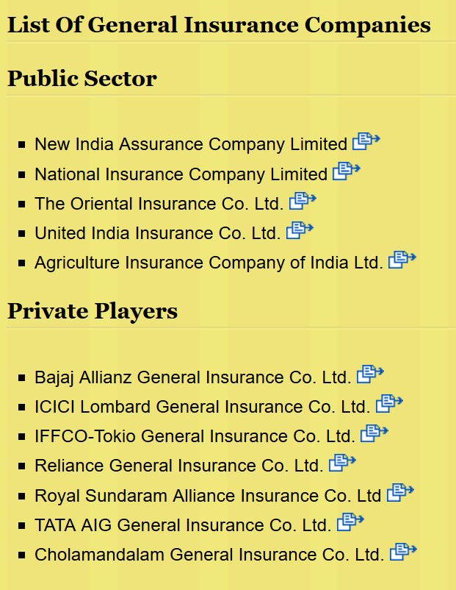
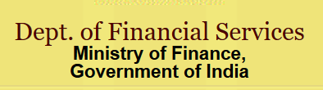
Notes:
http://financialservices.gov.in/insurance/ListOfLifeInsuranceCompanies.asp

Slide 39
What about foreign companies’ entry in India?
Narsimhan I (1991) & II (1998)
Malhotra Committee 1993
Foreign companies not allowed.
Allow Foreign Banks
Even Full fledge foreign banks allowed (as subsidiaries with 100% foreign ownership)
Max. they can do only JV (49%) with Indian company.

Slide 40

Insurance FDI: 49%-> should we raise to 74%? Disagree
Trade Union: Profit/target minded MNCs will not entertain employee unions' demands. “target driven private companies” / Whistleblower / claim-settlement=> Job Loss.
May use clients' money for speculative trading, investment in junk bonds to offer higher return => overleveraged companies =>Collapse of asset bubble/NPA
Foreign participants have their own norms in parent country -subsequently may lobby in India to relax its norms, loopholes in taxation / capital gains / royalties.

Slide 41

Insurance FDI: 49%-> should we raise to 74%? Agree
Will provide more capital-> economies of scale, cheaper ops., products, for increasing density and penetration
“Investment pattern”; IRDA-investigate, SAT appellate so mischief unlikely.
Publicly listed companies: independent directors, auditing norms, whistleblower protection, CSR.
Merger, consolidation of private and public insurance biz=> we can sell policies to 3rd world.

Slide 42
Backup / emergency / safety?
Bank
4% CRR
20.5% SLR
9-15% CRAR,
Insurance
Investment pattern
Solvency Margin
0-2.5% CCCB under BASEL-III
They’ve to buy deposit insurance from DICGC
They’ve to buy re-insurance from GIC
Notes:
https://rbi.org.in/scripts/bs_viewcontent.aspx?Id=2900

Slide 43

Premium->Life insurance->investment pattern
Type
Min
Max
G-Sec
Housing-Infra bonds
Others
25%
50%
15%
“Approved” securities
20%
fill 100%
RBI Reverse repo
Commercial Papers
AA rated Shares / debentures
Notes:
LIC’s compulsory investment in G-Sec: 50% only 15%

Slide 44


Premium->General insurance->investment pattern
Type
Min
Max
G-Sec
Union:20%
Social infra.
10%
Loans to States for Housing & Fire Equipment
5%
Approved Securities
70%
RBI Reverse repo
Commercial Papers
AA rated Shares / debentures
Notes:
LIC’s compulsory investment in G-Sec: 50% only 15%

Slide 45
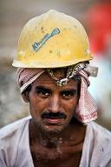

Financial inclusion?
Bank
40% PSL norms on SCB
25% Rural branching mandate on all commercial banks
Insurance
Rural & social obligation
75% PSL on RRB, SFB
Notes:
https://rbi.org.in/scripts/bs_viewcontent.aspx?Id=2900

Slide 46


Rural and social obligation on insurance companies….
Rural Area
Social
Rules
5k lives in 1st Fin.Year
…
25k lives in 10th Financial years
Census
unorganized workers, backward, PH, Poor
New amendment 2015:
+ insurance policies can be pledged for bank loans, as “financial assets”.

Slide 47

Micro-insurance
insurance
for poor / villagers / farmers
Life / General Insurance policy
Small sum insured (50k or less),
Premium Return: low | with / without.
Cover: individual / group
Policy/ Contracts must be given in local language
Intermediaries: NGO, SHG, MFI
E.g. LIC’s Jeevan Madhur (2006) and Jeevan Mangal (2009)
Notes:
AGENT: no edu. qualification, no exam.

Slide 48
Intermediary: AGENTs and Brokers
Agent
Only 1 LI, 1HI, 1GI
Corporate Agent
Earlier Only 1 LI, 1HI, 1GI
Broker
Multiple products
10 pass (R), 12 pass (U)
Exam: insurance institute of India + Training
Registration: controller of insurance, under 1938 ACT
Need Min. 50L To 250L capital depending on product category
Company must keep database even 5 years after he leaves
1/4/16: 3 LI, 3 HI, 3 GI
Banks, NBFCs
Bancassurance
“French” concept
Fraud / mis-selling : penalty from 1-25 crores.
Notes:
http://www.business-standard.com/article/finance/banks-keen-to-tie-up-with-multiple-insurers-116032200882_1.html
Insurance Amendment: puts all in one category of “Insurance intermediaries”
Pro: more choices to client, professional advice, less “target-misselling”
Anti: MoU have to be scrapped, bank staff not trained for multiple companies policies

Slide 49
Insurance intermediaries: 5 Types
Agents
Third Party Administrators
Brokers: multiple products
Banks (Bancassurance)
Corporate agents
Surveyor/ Loss Assessor
Confirm cause and quantum of loss.
Grade: A< B< C depending on experience and skill.
Financial limits, else only rubber stamp.
Intermediary between
Patient
Hospital
Insurance co.

Slide 50
What are the distribution channels for insurance?
Direct marketing
ICICI prudential (Life) direct flyers in lunchboxes, Mumbai
Outlets
Internet, policybazzar.com, Malls / stores
Automobile showrooms/ Cos.
Direct tie up for vehicle insurance
Forex dealers
Thomas cook, Western Union – for intl. travel insurance
Cargo
Marine - Airline: / shipping companies
Intermediaries
Agent, corporate agent, Bancassurance

Slide 51

Ombudsman: Protect Client from company!
Bank’95- ‘06, inspired from UK
Insurance’99
Matters upto 10 lakh
Hear matters upto 20 lakh
Conciliation and award making – binding on company
1995: Banking ombudsman, RBI GM, 3 years, no reappointment.
1938: act itself provides
1999: IRDAI setup
17 ombudsman, 3 years, no reappointment.
RBI has powers under “BANKING REGULATION ACT”
Area wise: Total 20 , incl. J&K (sits @Jammu)
All banks and loan giving NBFCs

Slide 52
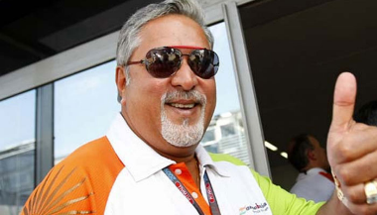
How to Protect Company from its Client?!
SARFAESI 2002
Insurance Act Amend’15
Attach Asset from client without court order. (DRT, DRAT)
IF Client suppressed facts, can be questioned but within first 3 years of buying policy.
Insolvency and bankruptcy code 2016
Notes:
This means even if the policyholder dies within the first three years and the claim is made after three years, the insurer has no recourse.
“If the policyholder dies in the first year itself, but the claim is made after three years, we will have to settle the claims,” said K.S. Gopalakrishnan, managing director and chief executive officer, Aegon Religare Life Insurance Co. Ltd.

Slide 53
Economy: 6 pillars + theory + current + BES17 (pre cum Mains)
1.Banking
6.HRD
2.Budget
3.BoP
4.Sectors
5.Infra
V1:c3,4
V1:c2,3,5,6,9,11(GST),12,13
V1c:5
V1c:7,11(Agri)
V1c:10
v1c:12, 14; Budget^Rail
Banking over.. Finance|insurance|Fin.inclusion

